Slide 1
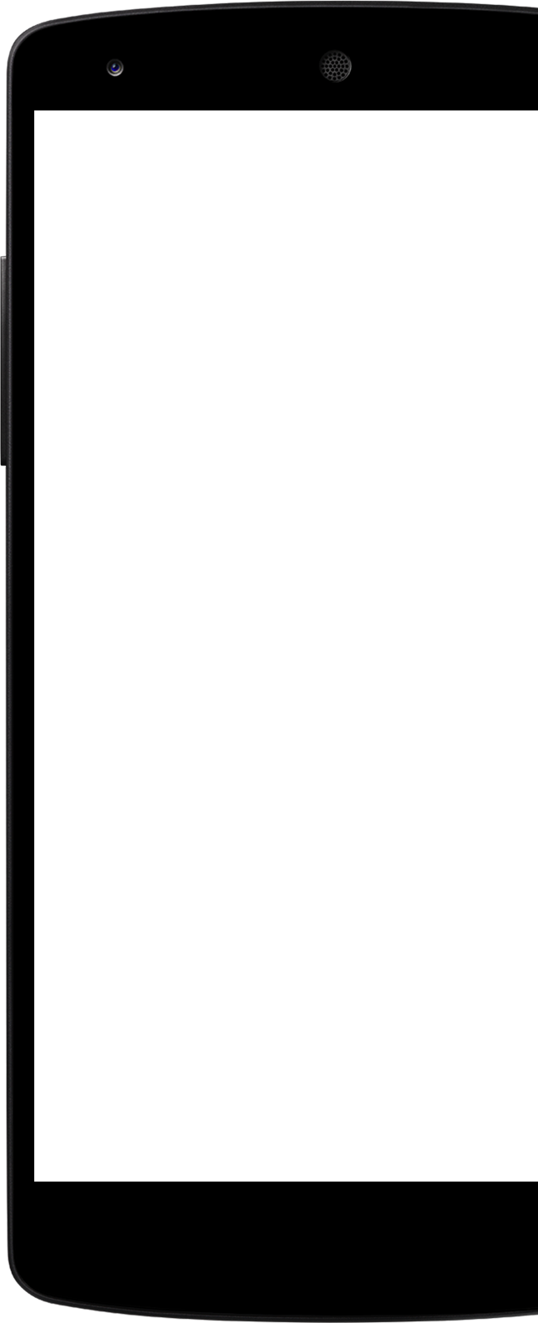

Design of An Automated Drink Dispensing System
By: Nathan Bane and Chris Blanks
Notes:
Chris

Slide 2
Outline
Background/Motivation
Design Requirements and Constraints
Planning & Design
Implementation Plan
Implementation
Acknowledgments
Questions?

Slide 3
Background/Motivation

Slide 4
Introduction
Long wait times are a detriment for any industry, especially the bar industry. By using automation and robotics to reduce wait time for the customer, larger profits and increased customer satisfaction can be achieved.
Notes:
Chris

Slide 5
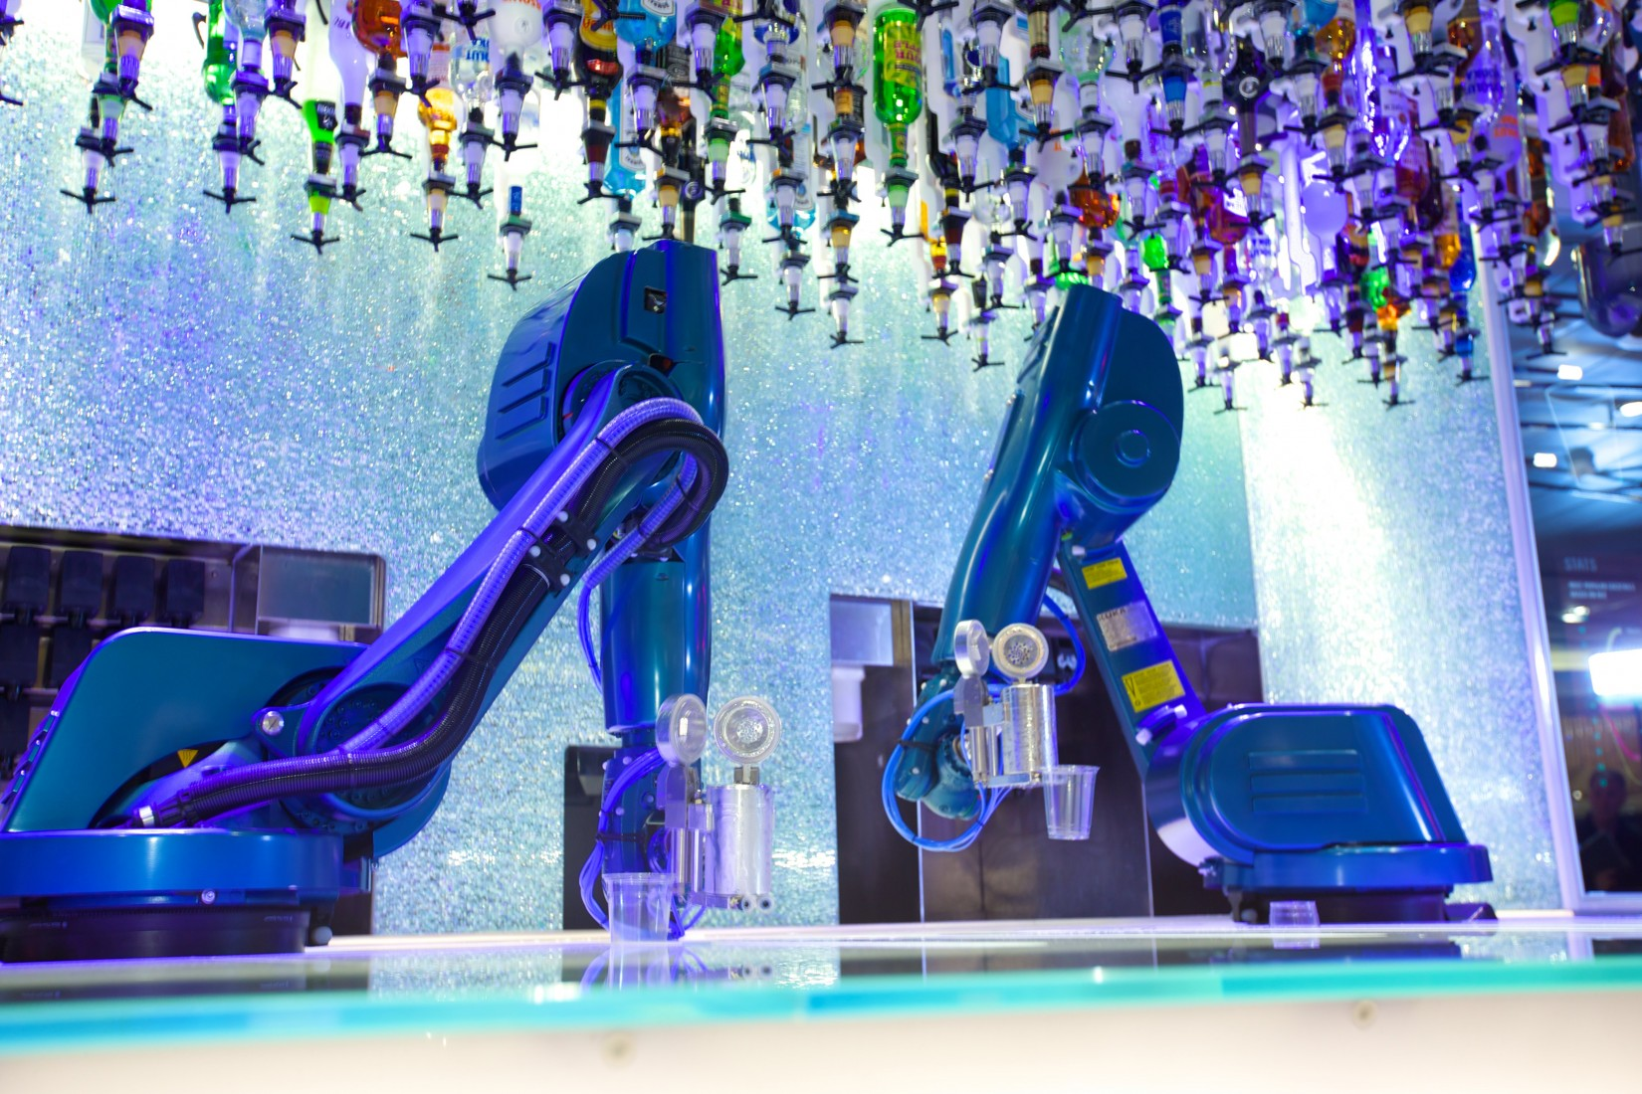
Market solution #1
Royal Caribbean Bar Tending Robot
Robotic arm based design
Suspended drinks with special spouts
Makes drinks that are stirred, shook, and muddle
Two drinks per minute
30 spirits and 21 mixers
Notes:
Chris

Slide 6
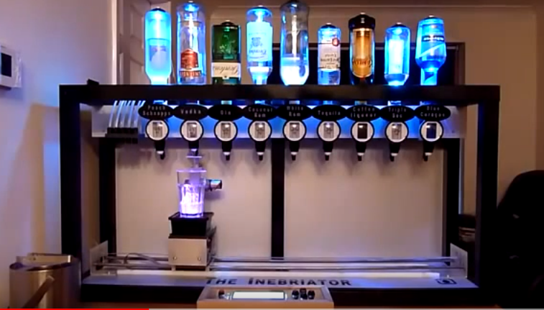
Market solution #2
Random Youtube Drink Making Robot
Linear translation to dispense drinks into cup
Beaumont Spirit Measure device
1 drink at a time
9 drinks available and suspended
Notes:
Chris

Slide 7
Objective
Design an automated drink dispensing system that will offer a more economical solution to reduce wait time for drinks and reduce human error in the drink making process.
Notes:
Nathan

Slide 8
Design Requirements and Constraints
Notes:
Nathan

Slide 9
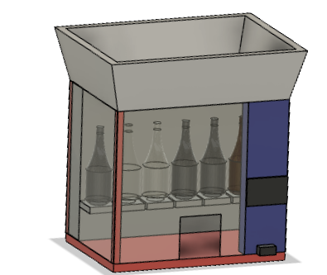
Design Requirements
General Specifications:
Dimensions: 3’ x 1’ x 2’ (lwh)
Dry Weight: 50 lbs
Power Requirements: 120V
Capacity: Bottles for 12 Liquids
Embedded System Specifications:
Broadcast shared data within 1 minute intervals
The high current devices will be separated from sensitive electronics (i.e. microcontroller)
Notes:
Nathan

Slide 10

Design Requirements (continued)
Features
Touchscreen User Interface for the Main Computer
Dual Mode for Desktop Application
Security
Remote Monitoring
Notes:
Nathan

Slide 11
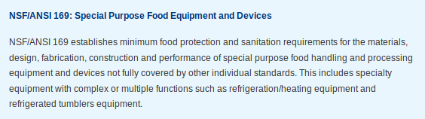
Design Constraints
Has to be on a raised platform to be close to eye level for users
For commercial development, system must adhere to common food equipment rules:
Notes:
Chris

Slide 12
Planning & Design
Notes:
Nathan

Slide 13
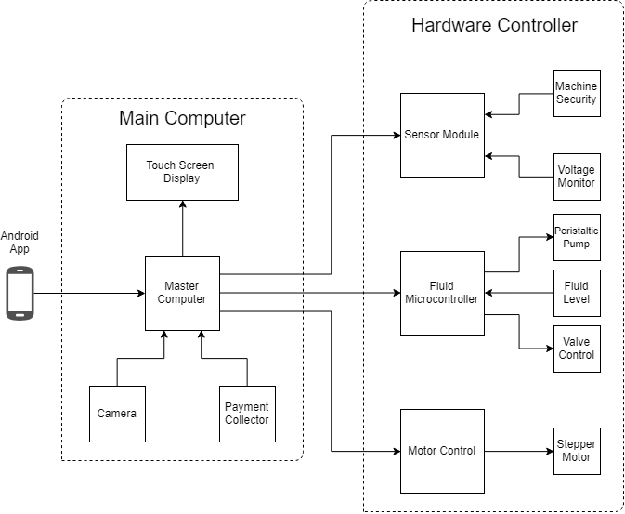
System Description
Notes:
Nathan

Slide 14
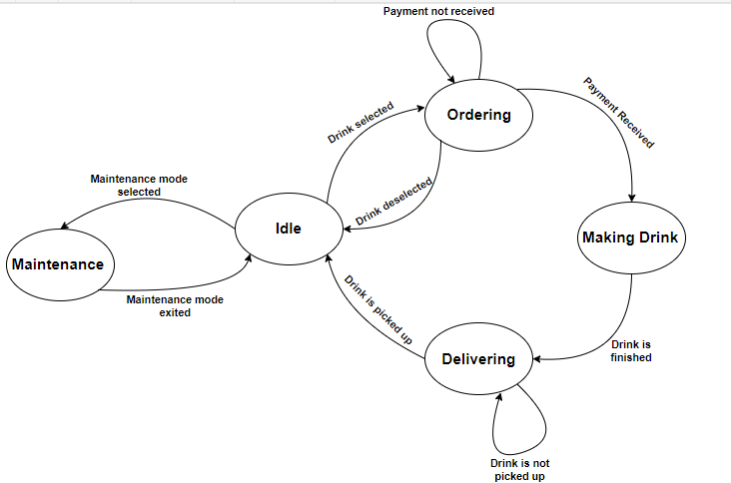
System States
Notes:
Chris

Slide 15
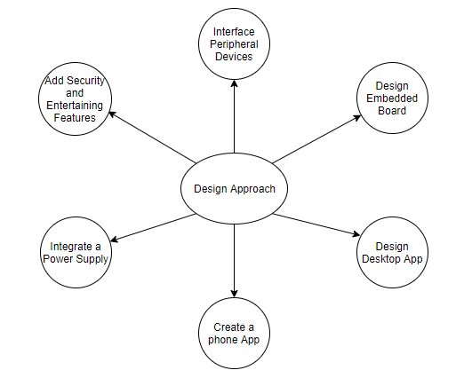
Design Approach

Slide 16
Implementation Plan
Notes:
Nathan

Slide 17
Tasks
Design a Fluid Control Hardware PCB
1.1 Design a High-Side Switch:
1.2 Design a Motor Driver:
1.3 Design a I2C GPIO Expander and Supporting Circuitry
1.4 Design a I2C Thermometer and Supporting Circuitry
1.5 Design a I2C Input Power Current Sensor
1.6 Design a Printed Circuit Board.
1.7 Create a Bill of Materials, Order Components and Printed Circuit Board
1.8 Assemble Components onto Printed Circuit Board.
1.9 Develop code for the printed circuit board to test assembly.

Slide 18
Tasks (continued)
2. Design Fluid Microcontroller Printed Circuit Board
2.1 Select Microcontroller and develop supporting circuitry for microcontroller
2.2 Interface switches with microcontroller to manipulate modes of microcontroller
2.3 Layout Printed Circuit Board
2.4 Assemble Components onto Printed Circuit Board
2.5 Code Microcontroller to receive commands through I2C from the master computer
3. Develop a communication scheme between the main computer and the fluid microcontroller board
Notes:
Nathan

Slide 19
Tasks (continued)
Create desktop application for the main computer
Design a GUI using Python’s Tkinter Library that the customers will use
Develop an efficient way to organize system and drink information in the file storage system
Add in capabilities for communication between the main computer and peripheral devices
Write code to interface the main computer with the embedded boards and peripherals
Create an Android phone application
Design the user interface of the phone app with Android Studio’s SDK
Allow the phone app to access the system information stored on the main computer and acquire relevant data for use within the app
Provide monitoring features (e.g. current stock left, low level of inventory, total sales)
Create extra capabilities and entertaining features
Incorporate facial recognition into the desktop application.
Adapt desktop application for compatibility with the Python Package index
Notes:
Chris

Slide 20
Team Organization
Time | Task | Comments | Responsible Personnel
Fall 2018 Semester
Week 1-5 | N/A | Project proposal and planning | Nathan Bane
Week 5- Week 7 | Task 1 (subtask 1.1,1.2) | Design and draw up a schematic for a high-side switch. Develop circuitry to control a brushed DC Motor .
Week 8- Week 10 | Task 1(subtask 1.3-1.5) | Design and layout circuitry to support an I2C Thermometer, Current Sense Circuitry, and I2C Gpio Expander
Week 11- Week 13 | Task 1(subtask 1.6-1.7) | Layout the components on the Printed Circuit Board and order Printed Circuit Board with parts
Week 13 - End of Semester | Task 1(subtask 1.8-1.9) | Solder components onto the printed circuit board and develop code to test the printed circuit board
Spring 2019 Semester
Week 1-4 | Task 2(subtask 2.1-2.4) | Choose a suitable microcontroller and develop supporting circuitry. | Nathan Bane
Week 5- Week 8 | Task 2(subtask 2.5-2.6) | Layout printed circuit board, order components , and assemble components onto printed circuit board | Nathan Bane
Week 9 -End of the semester | Task 2(subtask 2.4 ), Task 3 | Develop Code for Embedded. Develop communication scheme between master computer and fluid microcontroller | Nathan Bane & Christopher Blanks
Notes:
Nathan

Slide 21
Team Organization
Time | Task | Comments | Responsible Personnel
Fall 2018 Semester
Week 1- Week 9 | Task 4 (subtask 4.1, 4.2, 4.3) | Design and create the main application. Test the inputs and outputs of the system, so that it will interface correctly with the embedded boards and other peripherals. | Chris Blanks
Week 10- Week 15 | Task 5 (subtask 5.1, 5.2, 5.3) | Design and create the phone application.
Spring 2019 Semester
Week 1-2 | Task 6 (subtask 6.2) | Restructure desktop application software for compliance and compatibility with the Python Package Index
Week 3-Week 10 | Task 4(subtask 4.4 ), Task 6 (subtask 6.1) | Finish interfacing and testing the main computer/application with the other systems. Incorporate facial recognition into the main application.
Week 11 - End of the semester | N/A | Documentation. Testing and updating source code.
Notes:
Chris

Slide 22
Implementation

Slide 23
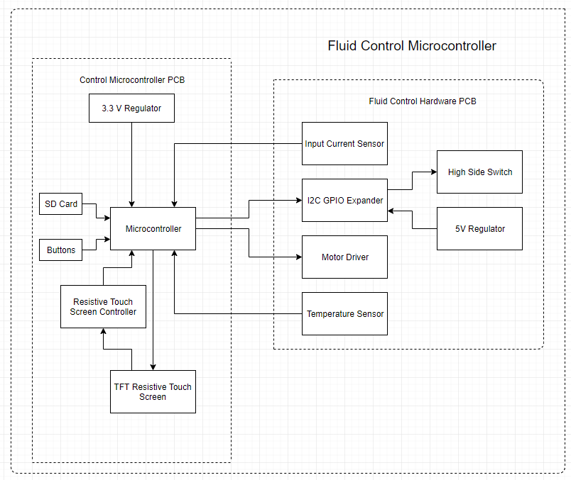
Task 1 - Fluid Microcontroller System Diagram
Control Microcontroller PCB
Purpose
Isolates ground planes from current loops
Fluid Control Hardware PCB
Interfaces with the valves and pumps
Specifications:
12-24V | 8.5 - 17 A
3.3 V GPIO Input
Notes:
Nathan

Slide 24
Task 1 - Fluid Control Hardware
The Fluid Control Hardware will be the interfacing hardware between the microcontroller and the motors and valves.
Input Voltage: 12 - 24V
Max Current Draw: 12V - 17 A | 24V - 8.5 A
Digital Input Logic Voltage: 3.3 V

Slide 25
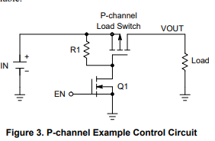
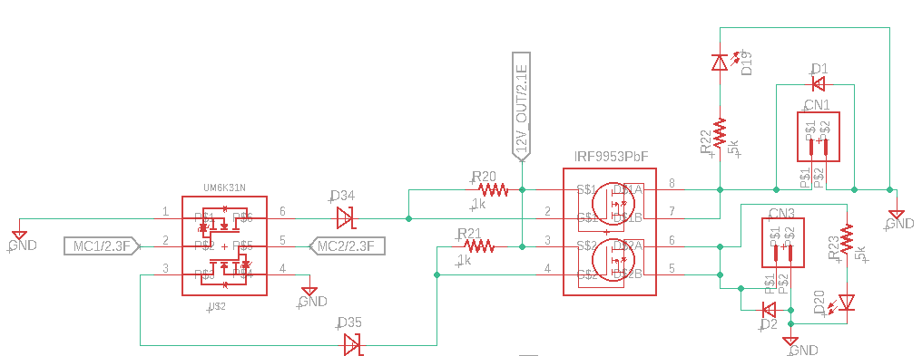
Task 1.1 - High Side Switch
A high-side switch allows devices to be disconnected from its power source.
Device: Solenoid Valve - 12-24V, 5-6 W
High-side switch requirements
Max Current: .5 A * 2 = 1 A
Max Voltage: 24 V
Logic Level (3.3 V) Control
A PMOS pass transistor was chosen over an NMOS transistor because it is simpler to control.

Slide 26
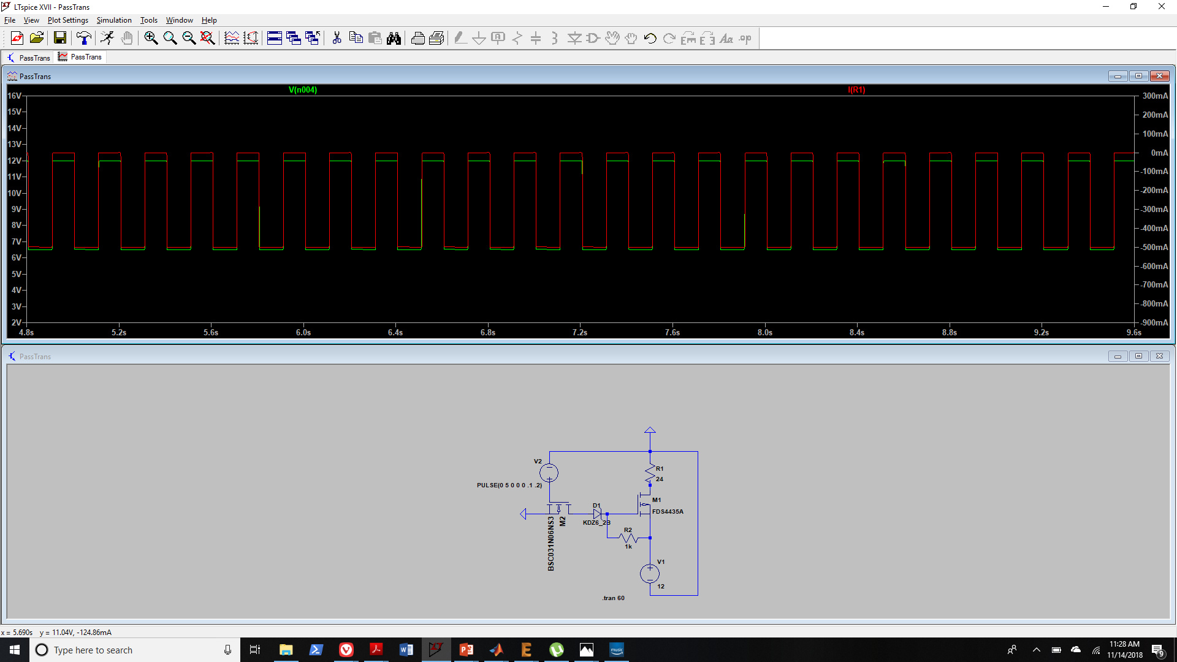
Task 1.1 High Side Switch Simulation

Slide 27
Task 1.1 - High Side Switch Layout
IRF9953PbF - PMOS Power Mosfet
Dual PMOS Package
Vds: -30 V
Vgs: +- 20V
Id: -1.8 A
Rds: .25 Ohm
UM6K31N - NMOS Logic Level Transistor
Dual NMOS Package
Rds: 2.4 Ohm @ 3.3 V VGS

Slide 28
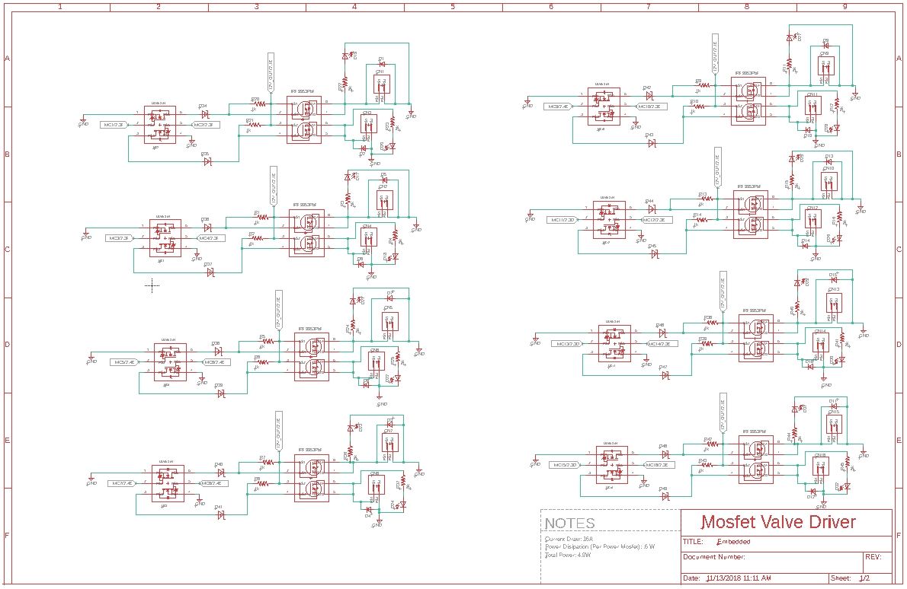
Task 1.1 High Side Switch Full Layout

Slide 29
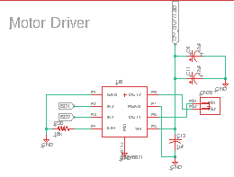
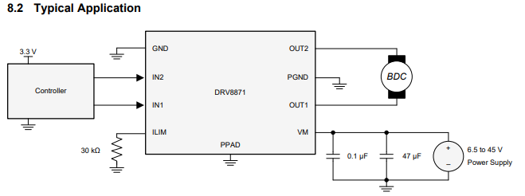
Task 1.2 - Motor Driver
Fig 1: Schematic
Power Requirements for Peristaltic Pump:
Voltage: 12V
Current: 2.5A
Texas Instruments DRV8871
Voltage: 6.5-45V
Current: 3.6 A
Control: PWM
Integrated Protection Features:
Overcurrent Protection
Thermal Shutdown
Fig 2: Data Sheet Configuration

Slide 30
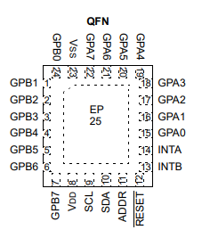
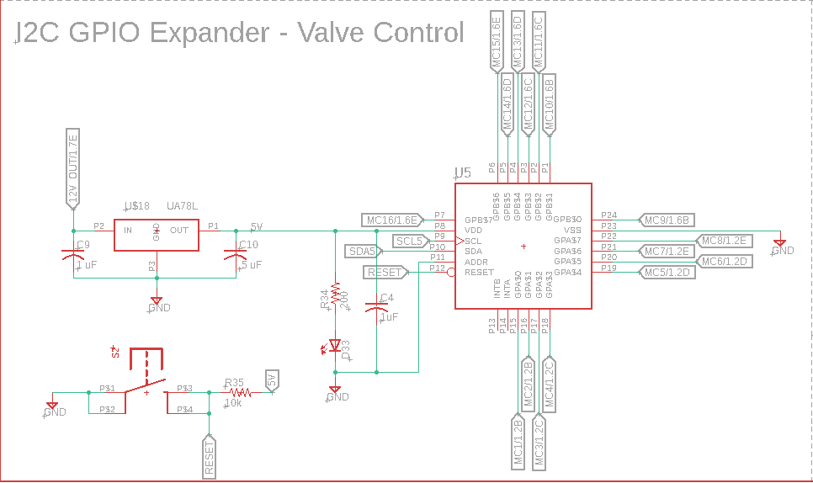
Task 1.3 - I2C GPIO Expander
The purpose of the I2C GPIO Expander is to limit the number of pins needed on the microcontroller to control the valves:
MCP23018:
5.5V 25mA (per pin)/ 400mA Total
I2C Interface Frequencies:
100 kHz
400 kHz
3.4 MHz
16 Pins
Open Drain

Slide 31
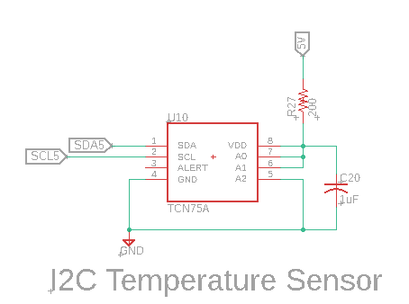
Task 1.4 - I2C Thermometer
The purpose of the I2C GPIO Thermometer is to monitor the overall temperature of the board to determine status of motor drivers
TCN75A:
Temperature Range: -40C - 125C
Accuracy: 0.0625C to .5C
I2C Interface Frequencies:
100 kHz
400 kHz

Slide 32
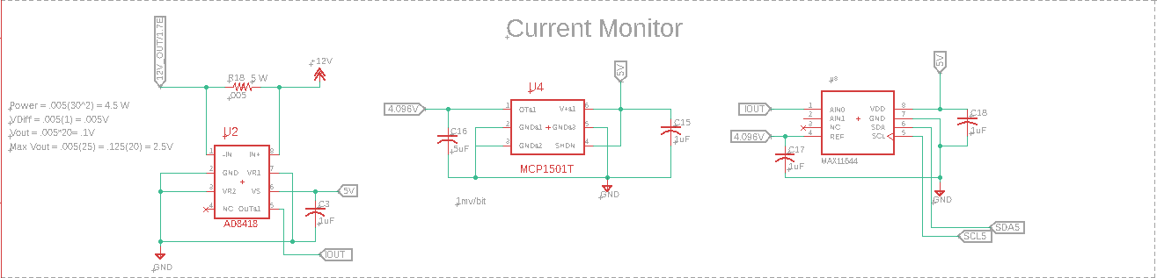
Task 1.5 - Input Current Sensor
It is important to be able to monitor the current draw of the board to determine the function of all components on the board.
Specifications:
Current Range: 50 mA - 25 A
Resolution: 10 mA/mV

Slide 33
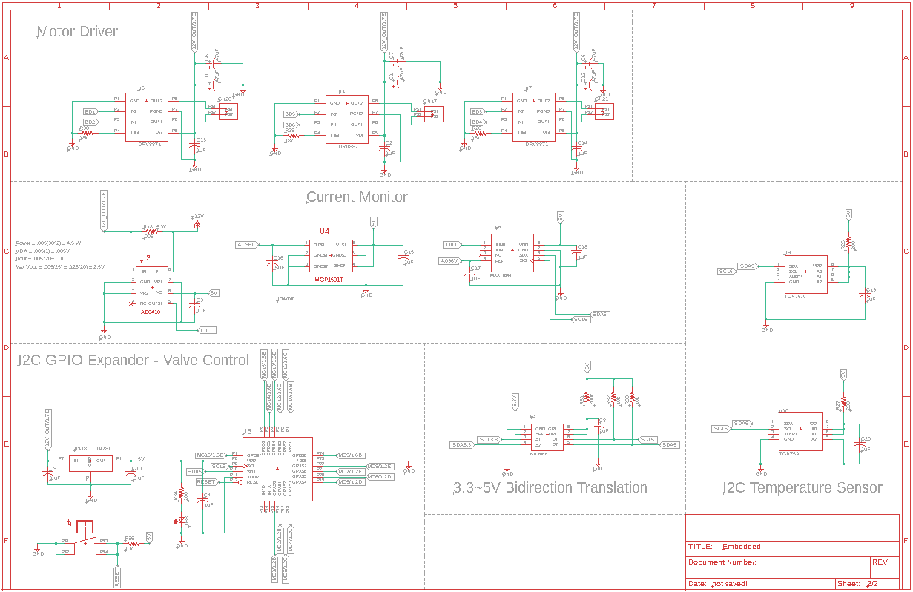
Current Status of Schematic

Slide 34
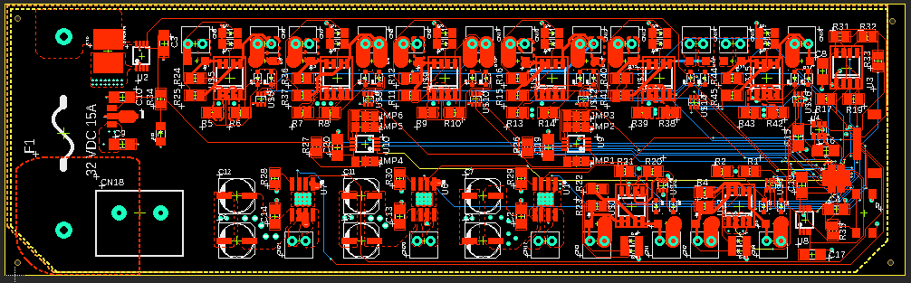
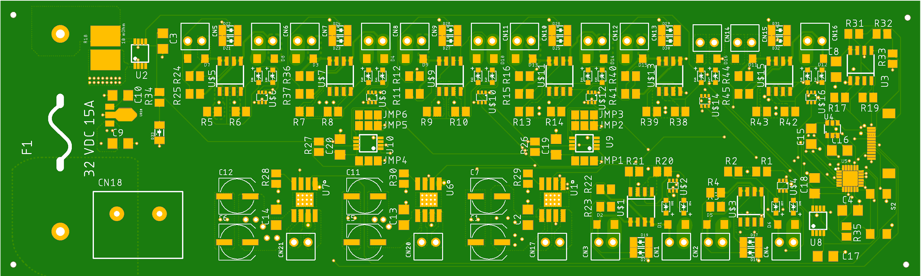
Task 1.6 - Layout Printed Circuit Board
Design Rules
4 - Layer Board
Signal 1
Power
GND
Signal 2
Large Copper Pours to Handle Current

Slide 35
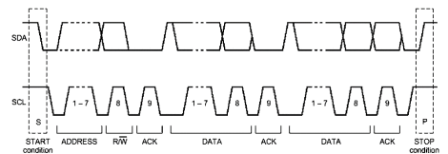
Task 1.9 - Develop Test Code I2C
What is I2C?
I2C Communication Protocol consists of two wires the Serial Data Line (SDA) and Serial Clock (SCL) which are held logic high.
Each I2C device on the PCB has its own unique address - Address: 0X40 H
Generating Code consists of reading the datasheet to communicate with each register to manipulate the device.
MCP23018 - Important Registers
IODIRA - Input/Output Direction Register - Bank A - Address: 0x00 H
GPPUA - GPIO Pull-Up Resistor Register - Bank A - Address: 0x0C H
GPIOA - General Purpose I/O Port Register - Bank A - Address: 0x12 H

Slide 36
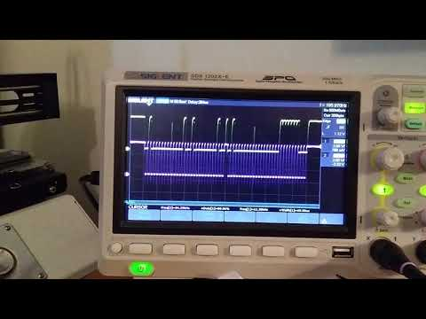
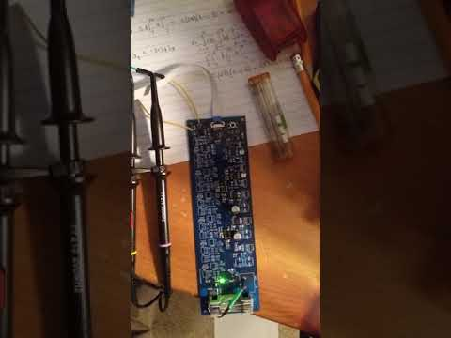
Task 1.9 - Develop Test Code I2C
I2C Signal
MCP23018 - GPIO Expander

Slide 37
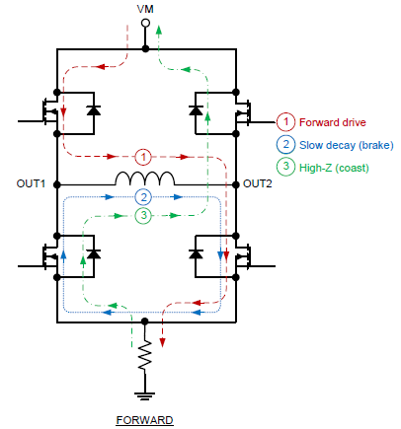
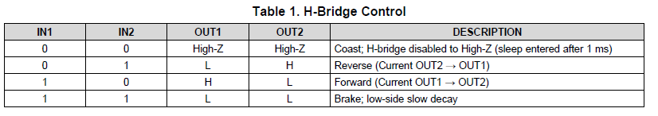
Task 1.9 - Develop Code to Control Motors
What is PWM?
PWM (Pulse Width Modulation) is a communication scheme that divides a voltage signal into repeating pulses that can vary from 0% to 100% of the period.
The motors will use the average of the voltage signal.
STM32L476 has 7 general purpose timers that will allow us to control up to 6 motors as one time.
Each motor is controlled using 2 pwm pins allowing the ability to control direction such as forward, backward and coast

Slide 38
Task 2.1 - Select Microcontroller
STM32 L476RGT6
32-Bit ARM Cortex-M4 80 MHz Microcontroller by STMicroelectronics
Why ARM - STM32?
I would like to learn ARM programming
STM32 has an extensive tool support for the microcontrollers
STM32CubeMX - Graphical User Interface for setting up pins on a microcontroller by generating code that can be used.
STM32HAL - A hardware abstraction layer that makes the STM32 as easy to program as an Arduino.
The test code utilized a STM32L432 - Nucleo-32 Development Board
51 I/0 Pins - 3 I2C Channels - 1Mbyte Program Memory - 1.71 V ~ 3.6 V

Slide 39
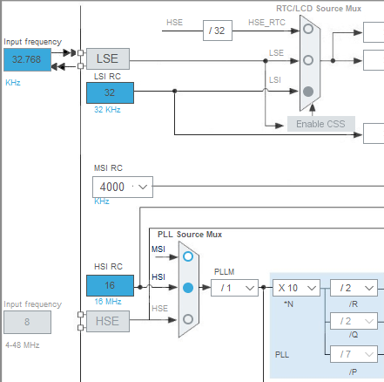
Task 2.1 - Layout of Microcontroller
STM32L476RGT6 | 32-Bit ARM Cortex-M4 80 MHz Microcontroller
51 I/0 Pins - 3 I2C Channels - 1Mbyte Program Memory - 1.71 V ~ 3.6 V
The STM32L476RG requires two crystals to provide a standard clock signal for the microcontroller to operate.
High Speed External Clock: 4-48 MHz crystal/ceramic resonator oscillator with a capacitance in the 5-20 pF range
Low-Speed External Clock: 32.768 kHz crystal
Power Supply - STM32 requires 3.3 V at 375 mA to operate.
SPX3819M5 3.3V 500 mA Linear Regulator
JTAG Programming - Supporting pins

Slide 40
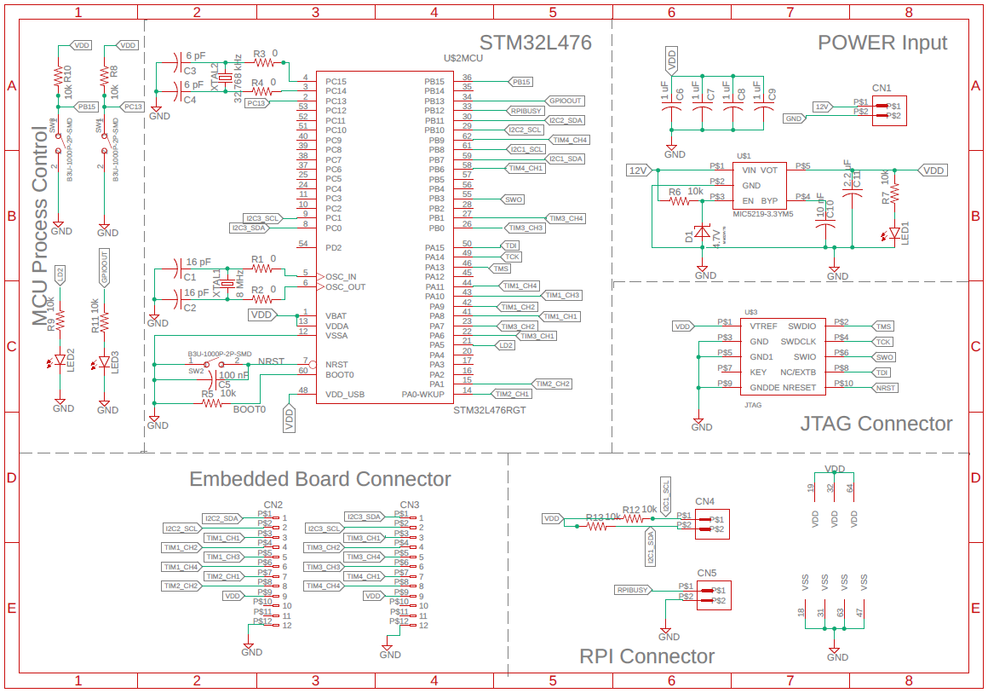
Task 2.1 - Schematic of Microcontroller

Slide 41
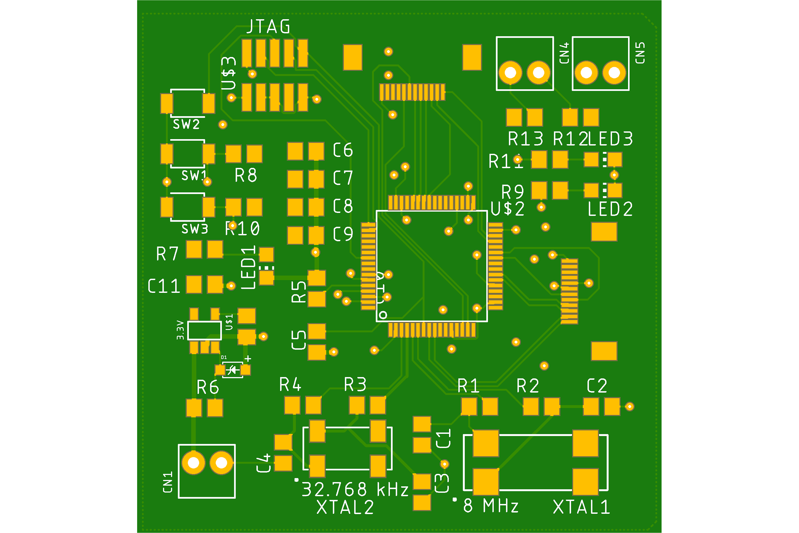
Task 2.3 - Layout Printed Circuit Board
The Microcontroller Board is a two layer board
It has a GND and Power Plane to make the movement of power simple and quick.
The layout begins with the microcontroller in the center and all the supporting connections surround it.
Has two connectors for two valve control boards allowing the design to be expanded in the future.

Slide 42
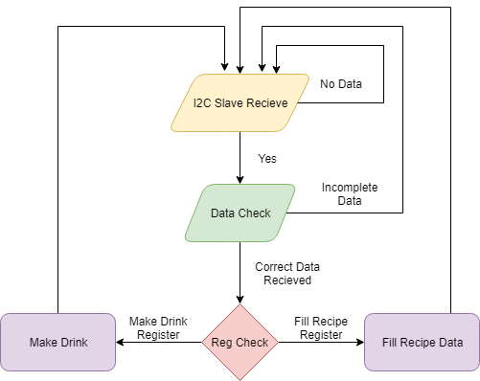
Task 2.5 - Main Loop Code
Main Loop
The main code is polling to see whether the main computer is sending data to the microcontroller through the I2C Bus
No data or the data is incorrect it continues to poll.
Data correct checks the status of register sent to determine task to operate
Make Drink - Operates valve control board.
Fill Recipe Data - takes in the recipes from the main computer

Slide 43
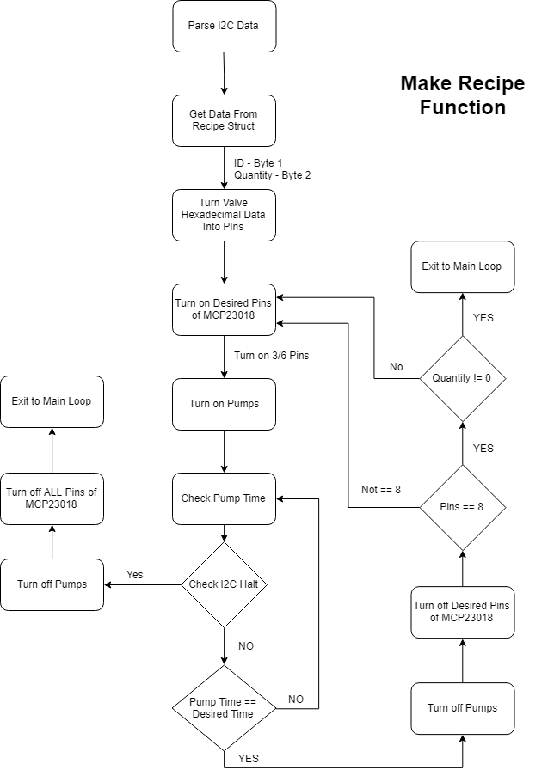
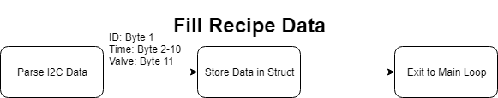
Task 2.5 - Main Loop Sub-functions
There are two sub-functions in the main loop: Make Recipe Function and Fill Recipe Data Function
Make Recipe: takes data stored in recipe struct and creates a drink based on the ID sent through I2C
Fill Recipe Data: Fills the recipe data struct with data sent through I2C

Slide 44
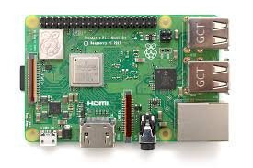
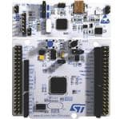
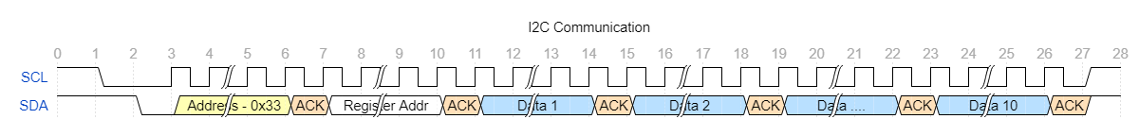
Task 3: Develop a communication scheme between the main computer and embedded boards
Creating a custom communication scheme between the main computer and embedded boards
Transmitting multiple bytes of data for commands and responses
Start drink making process
Halt drink making process
Send inventory information
Hardware pins for signaling when to communicate

Slide 45
Task 3: Develop a communication scheme between the main computer and embedded boards
Expression for converting ounces for recipe ingredients to uptime for pumps:
Max uptime
(constant, seconds, value = 30)
pump_time = int( oz * OUNCE_TO_ML_CONV / ( PUMP_SPEED_ML_PER_SEC * MAX_TIME / BIT_RES ) )
Uptime for pumps (variable, seconds)
Bit resolution
(constant, no units, value = 256)
Fluid ounce to mL conversion factor
(constant, fl. oz/mL, value= 29.5753)
Number of ounces for ingredient (variable, ounces)
*Result is rounded down to nearest integer
Pump speed in Milliliters per second
(dependent on pump used, mL/sec, value = 500/60)

Slide 46
Task 3 - I2C Communications
The communication between the STM32L4 and the Raspberry Pi 3 is conducted through I2C.
Each data stream is 12 bytes long - Each byte of data contains 8 bits of data and an acknowledge.
The Register Address determines the data path of stream.
Make Drink Data: has two useful bytes the ID of the drink and the quantity of the drink
Recipe Data: 8 bytes of time data and 1 byte of valve data

Slide 47


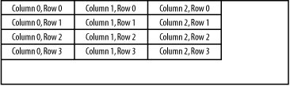
Task 4, Subtask 4.1: Design a GUI using Tkinter
Design Strategies:
Event Driven Architecture
Model-View-Controller OOP Pattern
Grid Geometry Manager
C.R.U.D
AES Symmetric key encryption

Slide 48
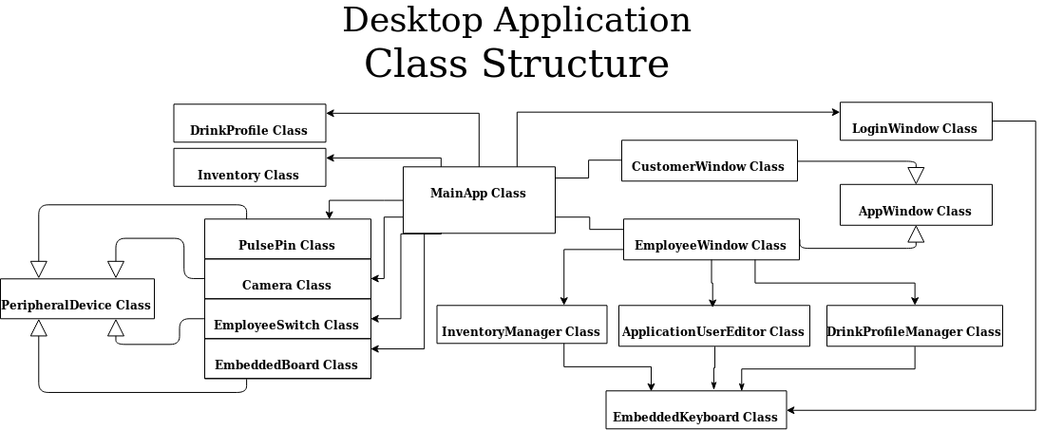
Task 4, Subtask 4.1: Design a GUI using Tkinter

Slide 49
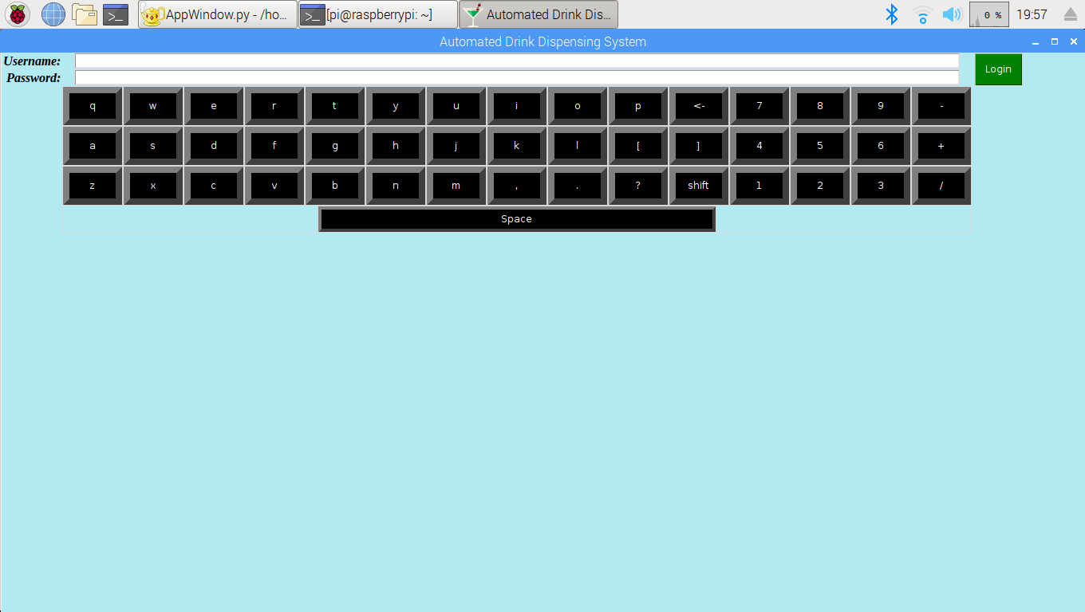
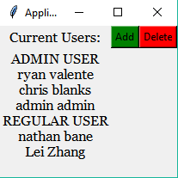
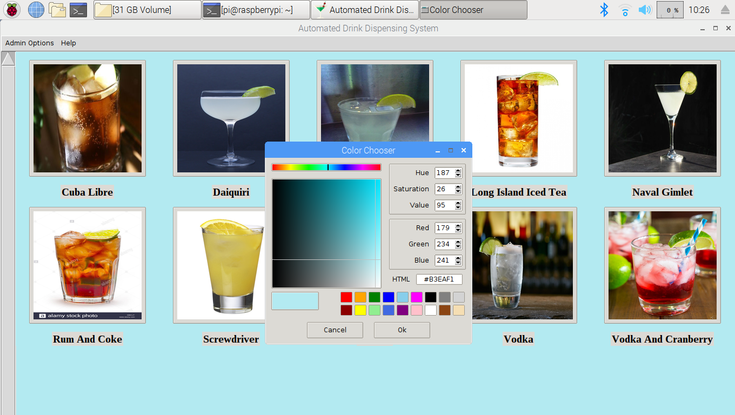
Task 4, Subtask 4.1: Design a GUI using Tkinter
Main Features of Desktop Application:
Login Page
User Management
Regular Employees & Managers
Customer mode
Offers a different ordering page for customers
Employee mode
Accessed on startup or after pressing a physical button
Inventory Management
Recipe Management
Logging of sales and inventory information
Displays all log information in GUI
Hosts a HTTP network
Displays current private IP Address in GUI
Displays hosting URL in GUI
Background color customization
Live 2D animations (a.k.a filters) via the Camera
Help Instructions

Slide 50
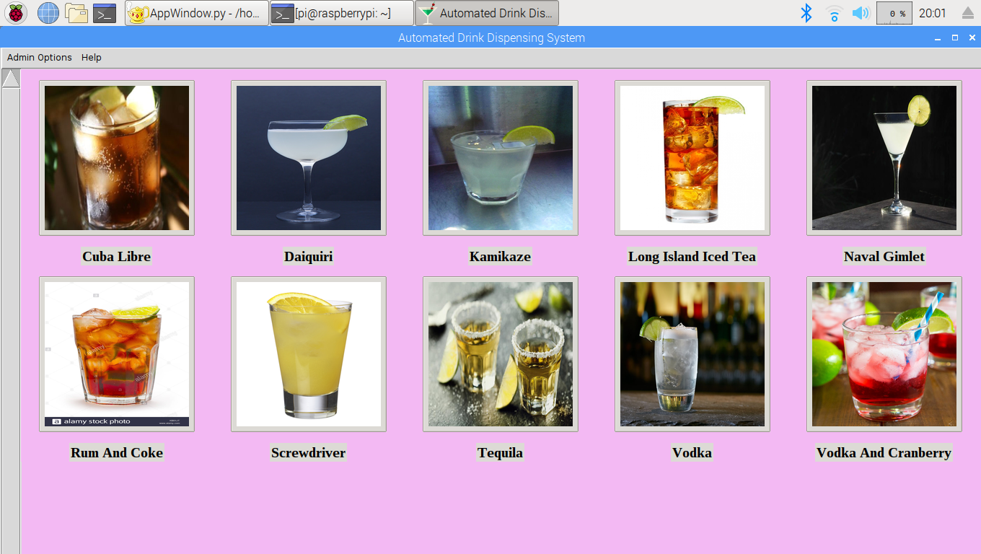

Task 4, Subtask 4.1: Design a GUI using Tkinter
GUI Icon
Main Employee Window

Slide 51
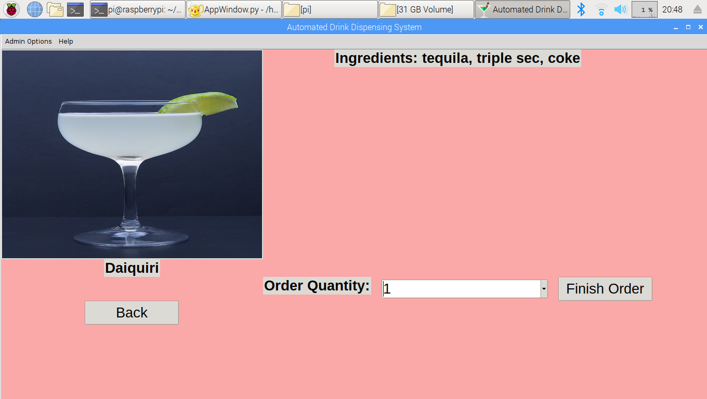
Task 4, Subtask 4.1: Design a GUI using Tkinter
Drink Profile In Employee Window

Slide 52
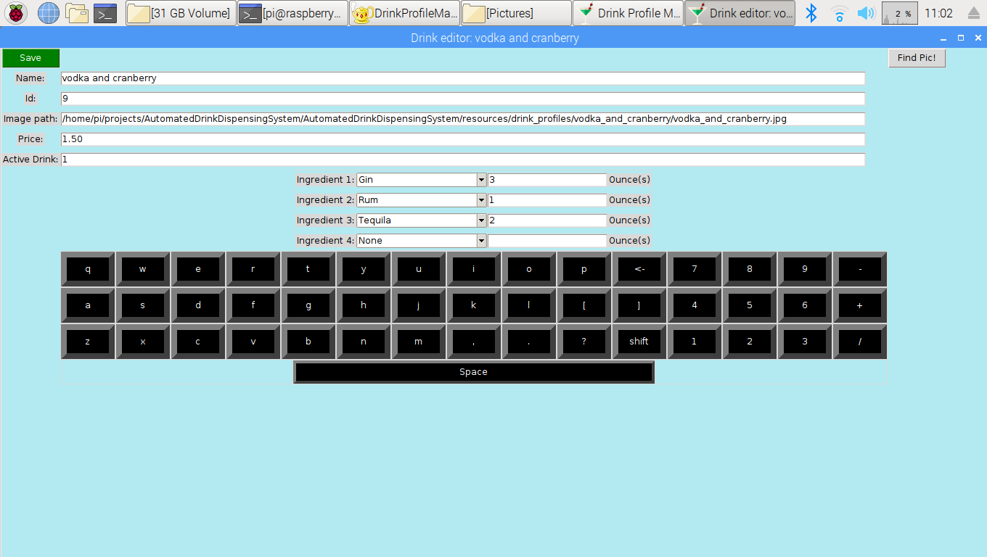
Task 4, Subtask 4.1: Design a GUI using Tkinter
Drink Editor

Slide 53
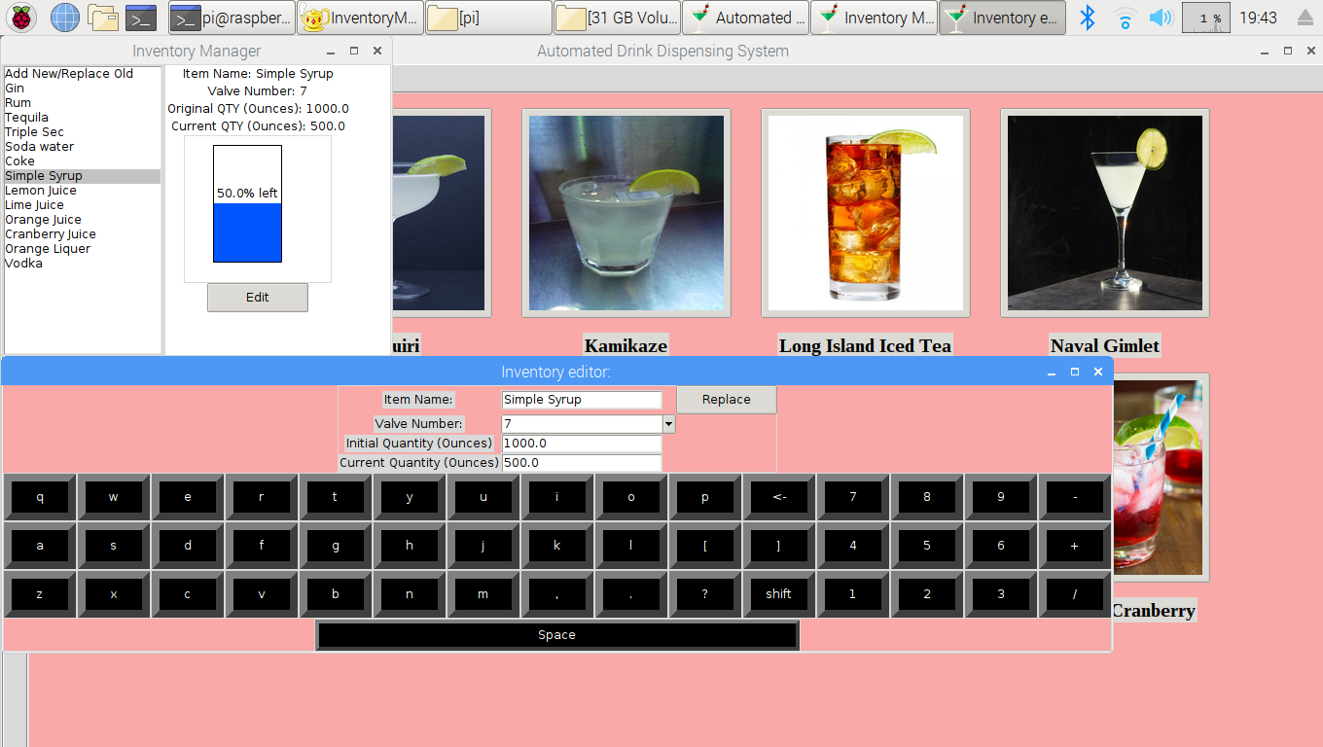
Task 4, Subtask 4.1: Design a GUI using Tkinter
Inventory Manager

Slide 54
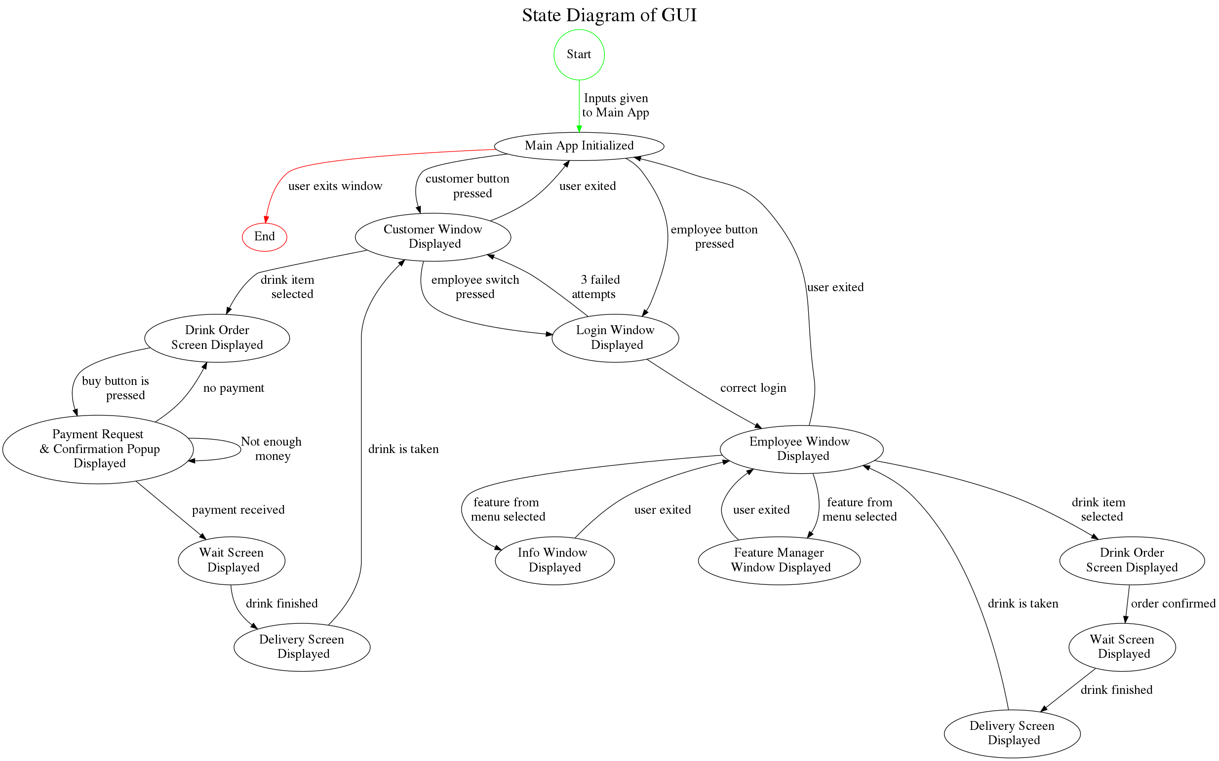
Task 4, Subtask 4.1: Design a GUI using Tkinter

Slide 55
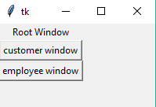
Task 4, Subtask 4.1: Design a GUI using Tkinter
Root Window
Login Window with Embedded Keyboard

Slide 56
Task 4, Subtask 4.1: Design a GUI using Tkinter
GUI Background Color Widget for User

Slide 57
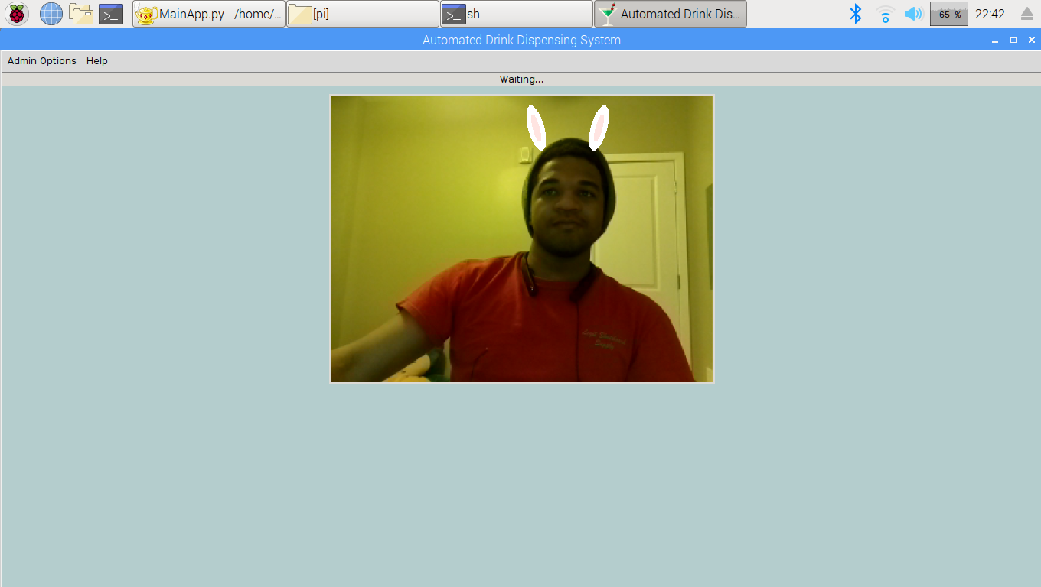
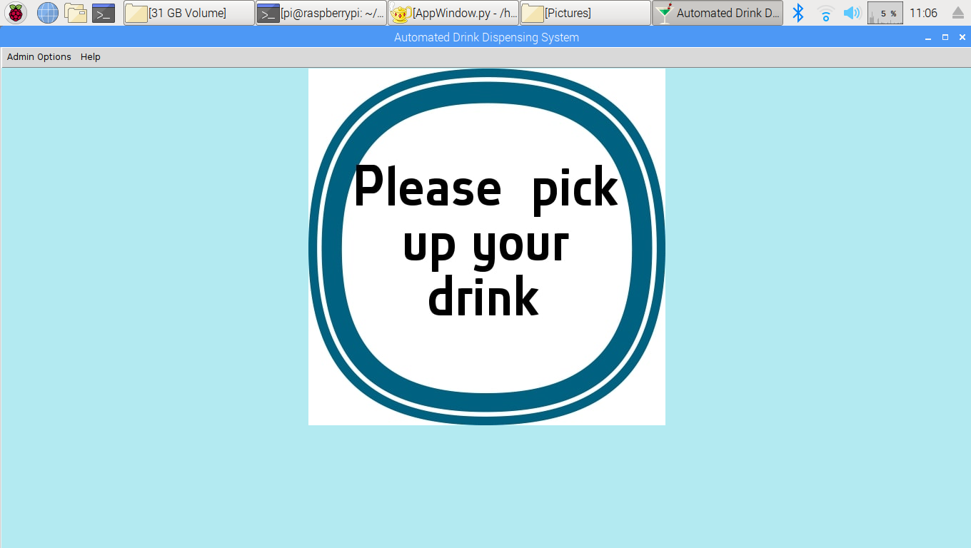
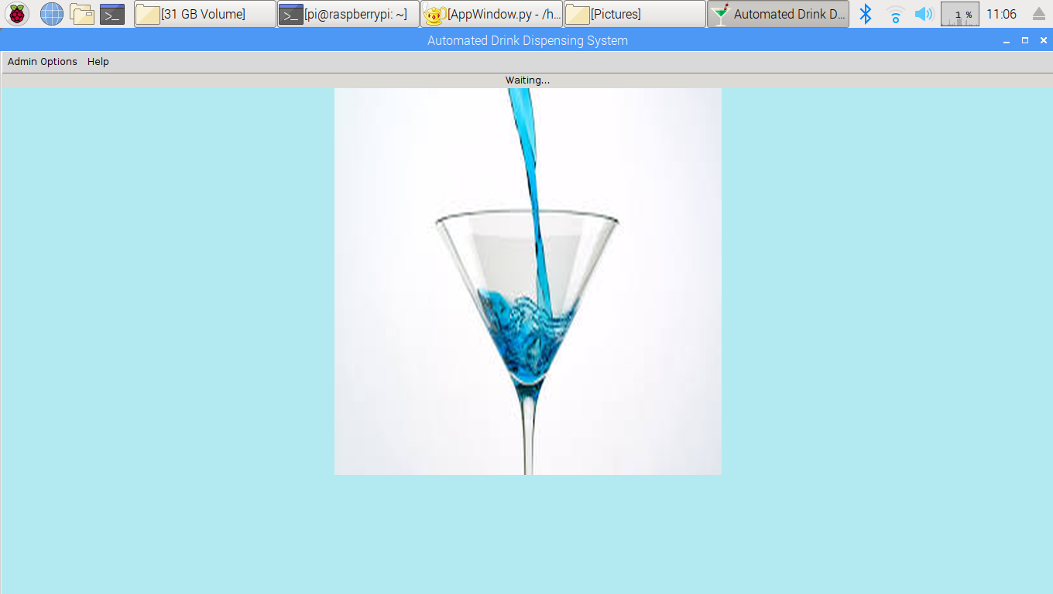
Task 4, Subtask 4.1: Design a GUI using Tkinter
Wait screens
Delivery screen

Slide 58


Task 4, Subtask 4.1: Design a GUI using Tkinter
Add a user
Add a user Window
Delete A User Window

Slide 59

Task 4, Subtask 4.1: Design a GUI using Tkinter
Log File Manager

Slide 60



Task 4, Subtask 4.2: Develop efficient methods for information management
Recipe info is stored in text files in the local directory
Inventory info is stored in a CSV file
Current background color stored in text file
Created an event logger for actions made by the user of the desktop application
Created a shared data directory that the HTTP server will share with the phone app

Slide 61

Task 4, Subtask 4.3: Add in capabilities for communication between the main computer & peripheral devices
The PeripheralDevice class defines a standard communication interface between peripheral devices & the main application

Slide 62


Task 4, Subtask 4.4: Create the interfaces between the main computer & peripheral devices
Employee Switch
Connected between a GPIO pin of the main computer (Raspberry Pi 3) and GND
When pressed, it sends the user directly to the login screen of employee mode
The state of the button is checked every 2 seconds by the application

Slide 63


Task 4, Subtask 4.4: Create the interfaces between the main computer & peripheral devices
MEI Bill Acceptor
Commercial grade bill acceptor that accepts $1, $5, and $10 bills (rejects $20s)
Dip switches for configuration
Needs an input voltage of 115 VAC
Outputs pulses by connecting an open collector configuration to ground
1 pulse per $1
Required software debouncing to get accurate amount of pulses
Payment Confirmation

Slide 64


Task 4, Subtask 4.4: Create the interfaces between the main computer & peripheral devices
Bill Acceptor Schematic For Reading Pulses

Slide 65



Task 4, Subtask 4.4: Create the interfaces between the main computer & peripheral devices
Picamera
Frames of a video feed are captured and displayed within the GUI
displayed until drink is finished
A randomly selected filter will be applied to a set of frames in order to add entertaining 2D animations
Made a CAD model and 3D printed it to hold picamera for testing

Slide 66

Task 4, Subtask 4.4: Create the interfaces between the main computer & peripheral devices
*Drink Ordering Process between Main Computer and MCU Board

Slide 67



Task 4, Subtask 4.4: Create the interfaces between the main computer & peripheral devices
Capacitive touchscreen with 3D printed mount
Standard HDMI connection for displaying desktop GUI
USB connection for touchscreen control on master computer
Square slots for feeding through wires (e.g. power wires, data ribbon)
50 degree angle for inclined support part
5-12 V for operation
9” diagonal

Slide 68



Task 5, Subtask 5.1: Design the UI of the phone app
Created a phone application via Android Studio
Phone application requires login credentials
Tabbed views once a successful login is achieved
App Icon
Login Page
Tabbed Views

Slide 69



Task 5, Subtask 5.2: Allow exchange of data between the phone app and main computer
Connects to the HTTP server hosted on the main computer
Loads inventory, sales, and system information into each their respective tabs
Allows for updating of shared data
Desktop app updates shared data every minute
Phone app uses URL generated by ngrok tool
Settings Options
URL Editor

Slide 70


Task 5, Subtask 5.3: Provide Monitoring Features in the App
The three tabbed views show:
Current inventory
Quantity left
Original quantity
Sales for specific days
A graph to show individual drink sales
System status information
A notification will be sent if the quantity left is half of the original quantity
Inventory Feature Tab
System Status Feature Tab

Slide 71

Task 6, Subtask 6.1: Incorporate facial recognition into the Desktop Application
Bunny Ears Feature
Using OpenCV Python API to detect potential faces within each image frame
Employing Haar Cascade Classifier, which is a cascade of functions that detects features
With the list of potential faces in an image, a 2D animation is drawn within the plane of the frame
Requires a bit of geometry

Slide 72


Task 6, Subtask 6.1: Create the interfaces between the main computer & peripheral devices
Math for Bunny Ears Feature:

Slide 73



Task 6, Subtask 6.1: Incorporate facial recognition into the Desktop Application
Rainbow mask
Using a Haar Cascade for detecting faces
Performing a cross-dissolve like operation to draw a transparent, multicolored mask onto the face of an observer
P_{new} [i, j]= β*P₁[i, j] + ɑ*P₂[i, j]+ ɣ
Rainbow glasses filter
Using a Haar Cascade for detecting faces and eyes
Drawing 2D glasses animation with built-in drawing functions and geometry

Slide 74



Task 6, Subtask 6.1: Incorporate facial recognition into the Desktop Application

Slide 75

Task 6, Subtask 6.1: Incorporate facial recognition into the Desktop Application
Rainbow mask and Glasses Filter in Full Demo

Slide 76

Task 6, Subtask 6.2: Adapt the desktop application for compliance with PYPI
Refactored code base to be compliant with Python Enhancement Proposals
Uploaded desktop application software to the Python Package Index (international software repository)
Allows for easier installation of desktop application software
Allows for a simpler updating process if new features are added
Supported for Python 3.5 & newer interpreters
Desktop app software package is specifically supported for the Raspbian Operating system (Debian based)
Excluding the peripheral device code, it will at least be able to run on Ubuntu variants (e.g. Lubuntu, Linux Mint)

Slide 77

Test Setup

Slide 78
Acknowledgments
We would like to acknowledge the weekly guidance that we received from Dr. Lei Zhang throughout our senior design courses.
We would like to acknowledge our friends and family for supporting us throughout this senior design project, especially David Salmeron who came down today.
We would like to acknowledge Justin Derickson for his help with fleshing out our ideas.
Finally, we would like to acknowledge Ryan Valente for helping out with some aspects of the mechanical portions of our system.

Slide 79
Questions?

Slide 80
References
http://www.royalcaribbean.com/connect/robot-bartenders-shake-things-up-at-sea/
https://www.youtube.com/watch?v=fAh6hQRKBU8
https://intellipaat.com/tutorial/tutorial-mongodb-tutorial/mongodb-crud-operations/
https://docstore.mik.ua/orelly/perl3/tk/ch02_02.htm
https://en.wikipedia.org/wiki/Model%E2%80%93view%E2%80%93controller
http://www.nsf.org/services/by-type/standards-publications/food-equipment-standards

